Slide 1
Dynamic Programming
Algorithms

Slide 2
Topics
Dynamic Programming
Fibonacci solution via Divide and Conquer
Introduction to Dynamic Programming
Shortest Path
Longest Common Subsequence
Knapsack

Slide 3
Divide and Conquer
Divide the problem into smaller subproblems
Conquer the subproblems recursively until the subproblem is small enough to solve
Example Binary Search, Merge Sort

Slide 4
Binary Search
Binary Search (array A, first, last, v)
If (last <first) output -1
Mid = (last + first) /2
If A[mid]= v output mid
If A[mid]>v
Binary_search (A, first, mid-1,v)
Else Binary_search (A, mid+1, last,v)

Slide 5
Fibonacci Example

Slide 6
Fibonacci Numbers
F(n)
If (n>=2) F(n)=F(n-1)+F(n-2)
If (n=1) F(n)=1
If (n=0) F(n)=0
Running Time
T(n)=T(n-1)+T(n-2)
=T(n-2)+T(n-3)+T(n-2)>=2T(n-2)
T(n)>=2T(n-2)>=2²T(n-4)>=2^{k}T(n-2k)
So when k= n/2. T(n)>=2^{n/2}T(1), exponential

Slide 7
Introduction to Dynamic Programming
“Programming” refers to a organized set of activities
Example Graduation program, TV program
Stores the results for small subproblems, and looks them up instead of recomputing
Used for recursive algorithms which would solve many subproblems repeatedly
Usually applied to optimization problems
Problems where there are many solution, but one is looking for the best (either maximum or minimum)
Ex: Shortest path between node a and node b

Slide 8
Shortest Path
Given a G=(V,E) and W edge weights of the edges and vertices s, t. Find the shortest path from s to t.
d(s,t)=distance of shortest path from s to t

Slide 9
Shortest Path
Un-weighted graph: BFS (breadth first search) (as opposed to Depth-First Search)
Single Source Shortest Path (SSSP)
O(|E|+|V|)

Slide 10
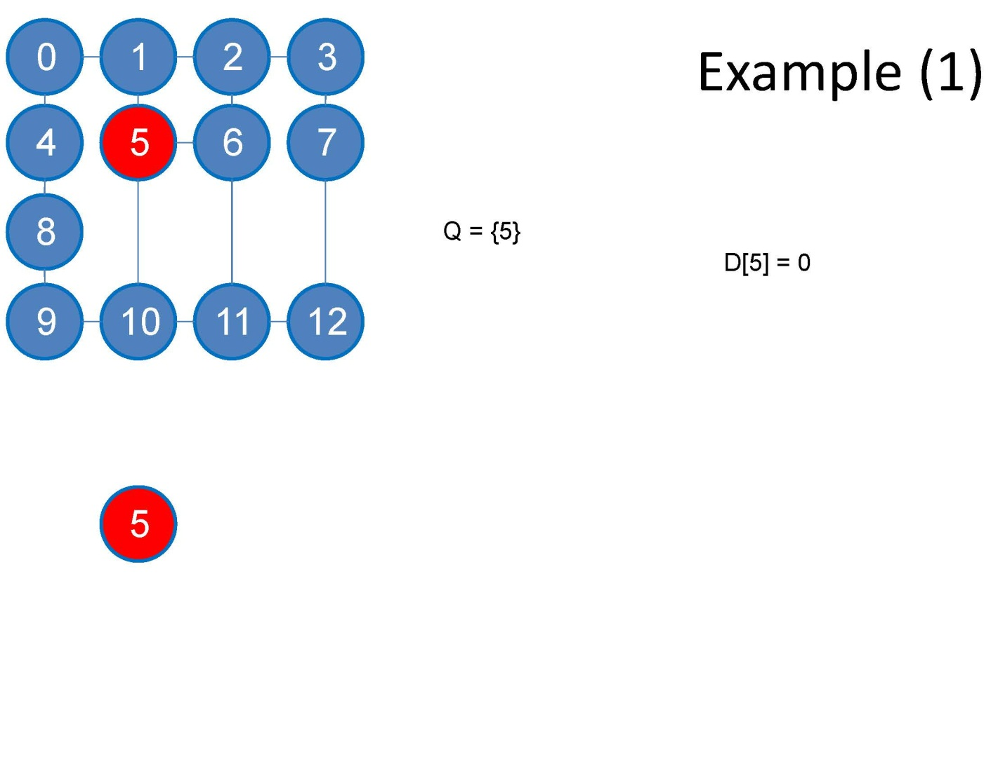
BFS

Slide 11
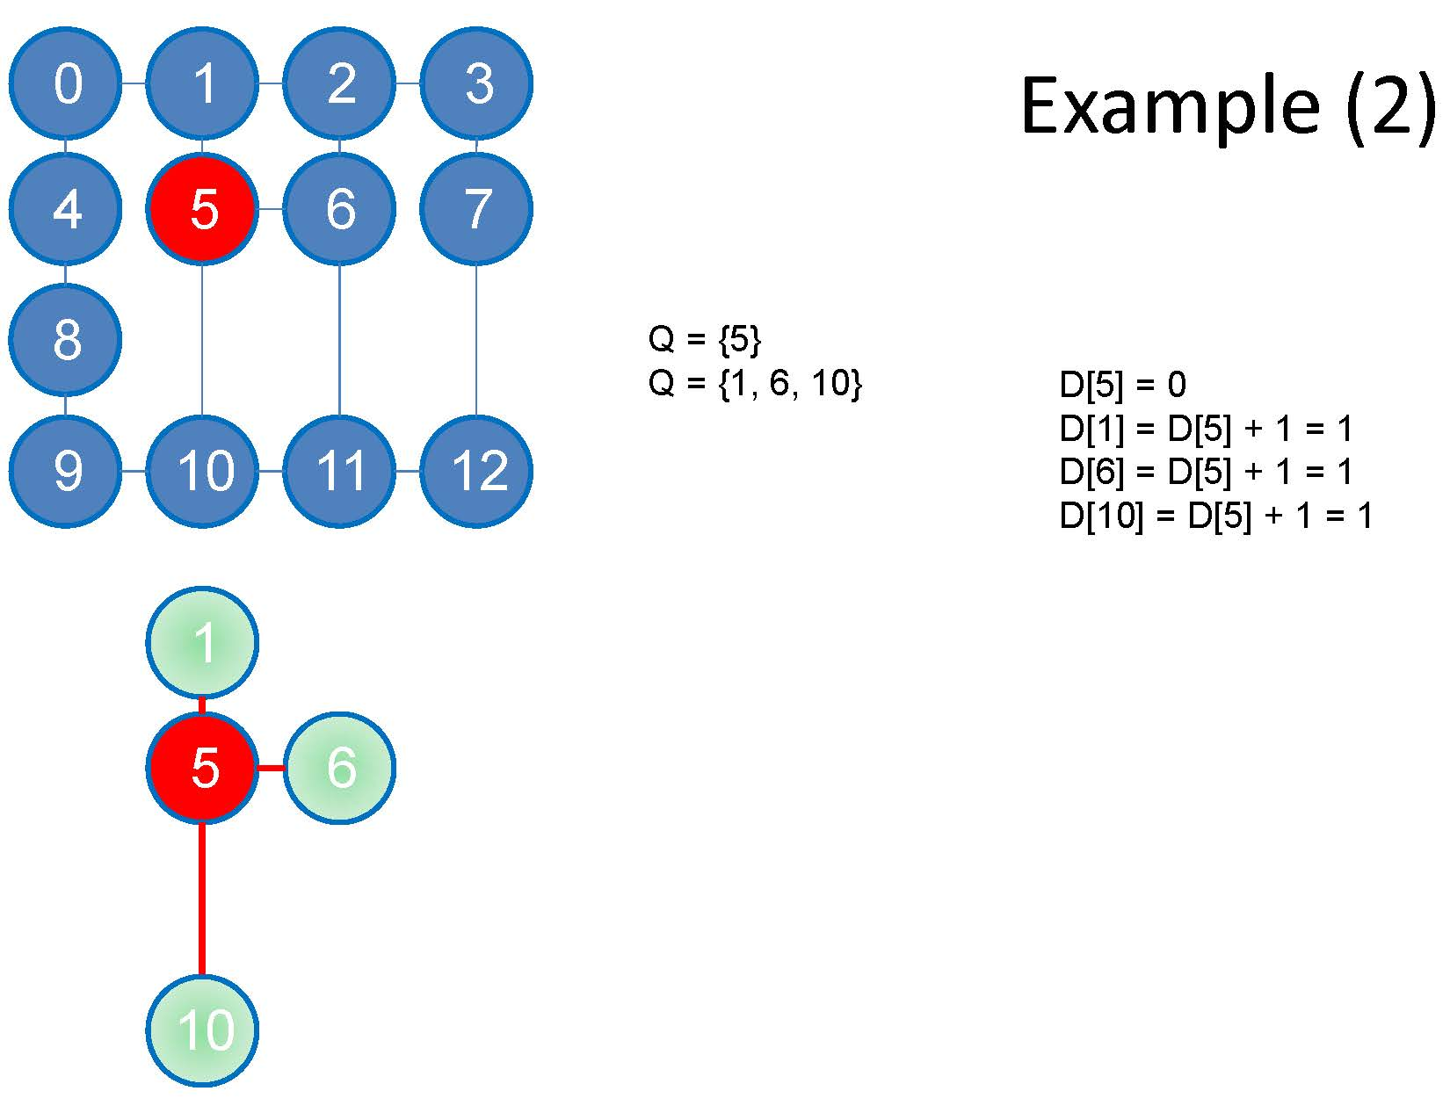
BFS

Slide 12
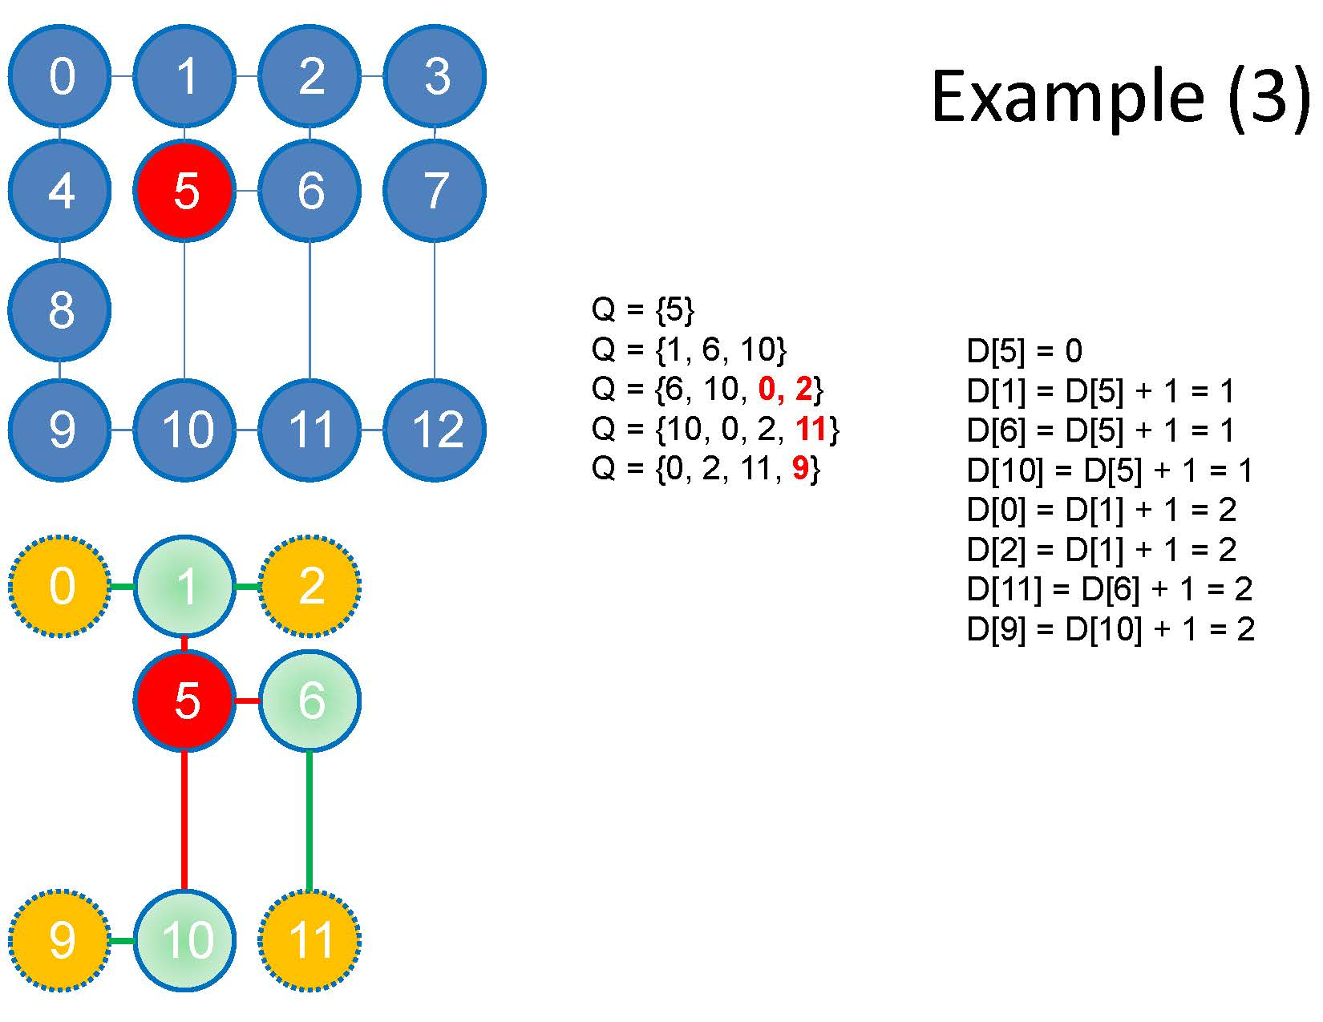
BFS

Slide 13
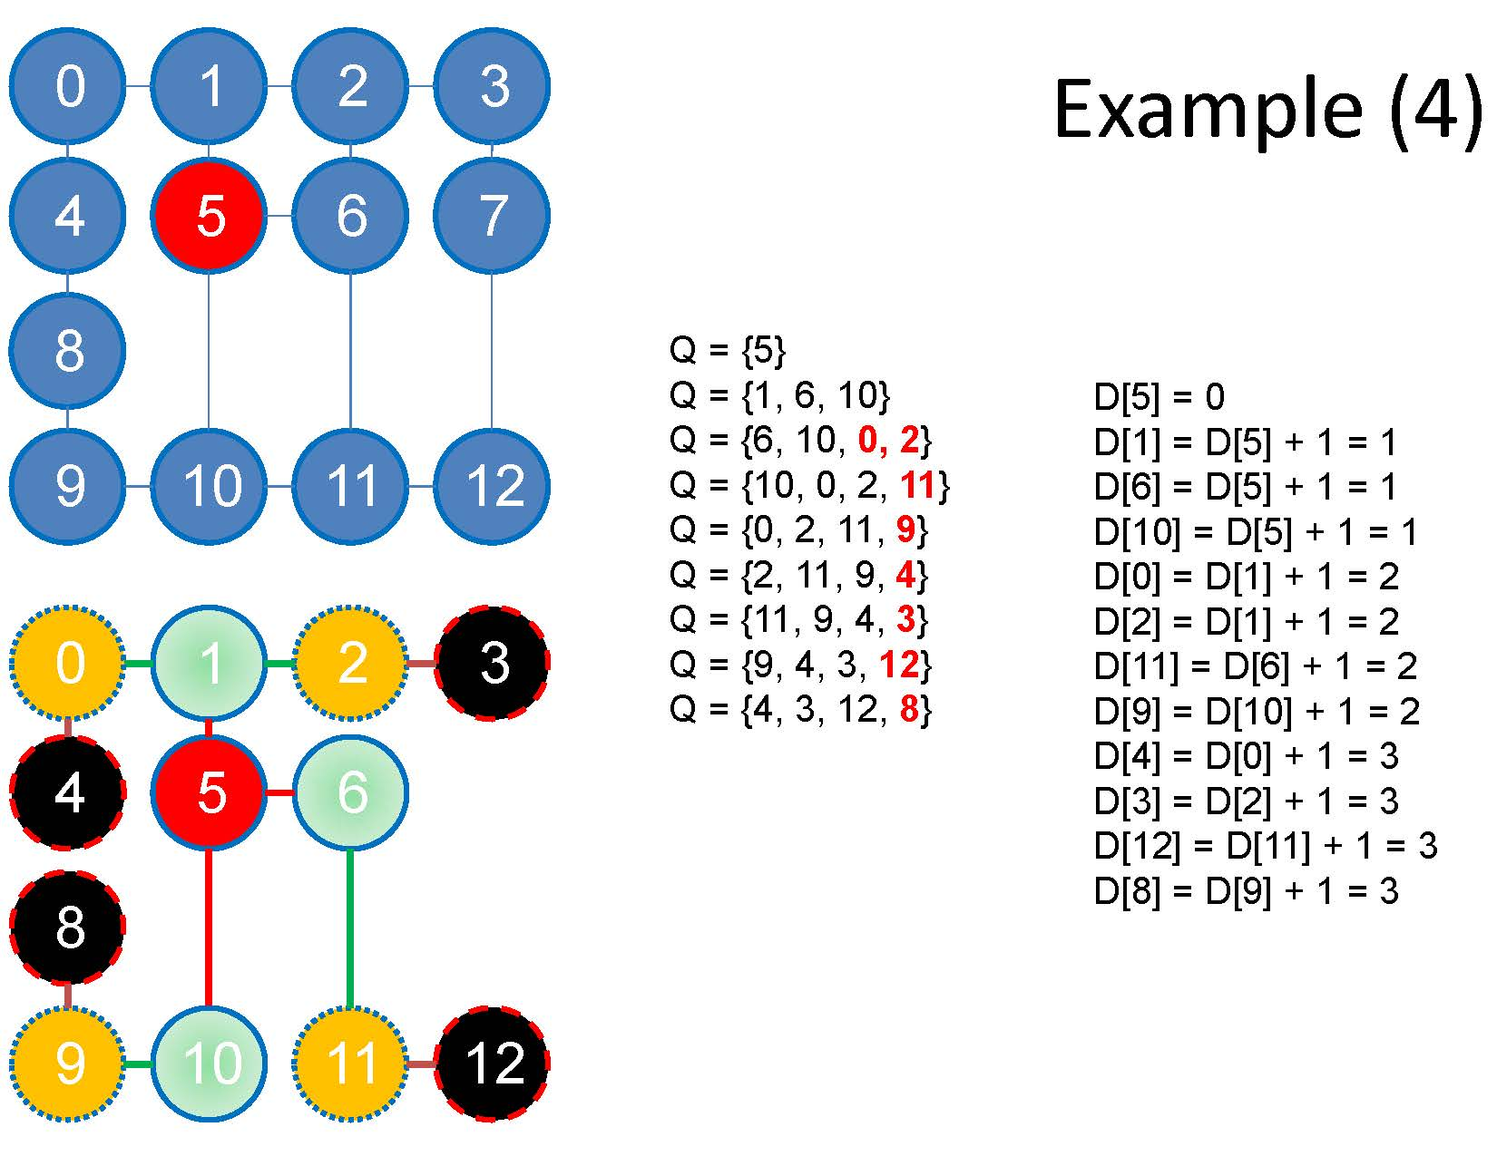
BFS

Slide 14
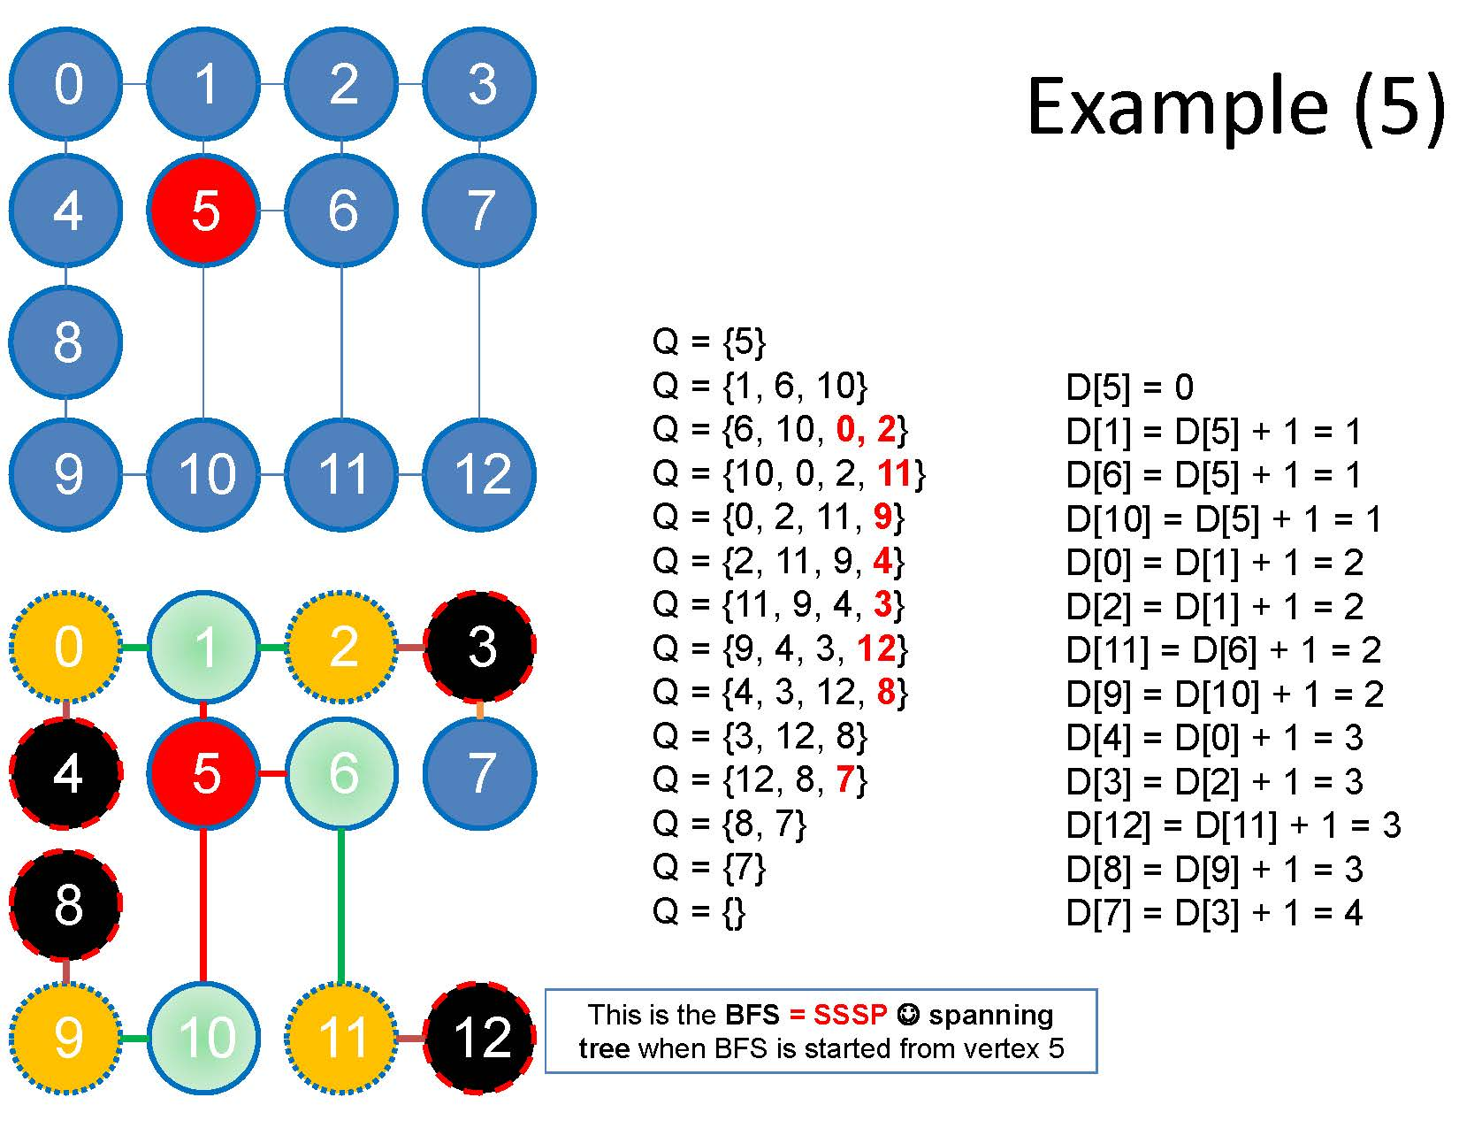
BFS

Slide 15
Floyd-Warshall Shortest Path
For edge e=(i,j)
Set d(e)=infinity if e is not an edge
otherwise set d(e)=w(e)
For k=1 to n
For i = 1 to n
For j= 1 to n
d(i,j)= min {d(i,j),d(i,k)+d(k,j)}
n³ running time (n<100): Floyd-Warshall
All pairs shortest paths: APSP
Can have negative weight

Slide 16
Bellman Ford
Single Source Shortest Path: SSSP
O(|V|²*|E|) if E=O(|V|²) what is running time
May have negative weight cycle

Slide 17
Dijkstra’s Shortest Path
Most famous (Dijkstra’s algorihtm)
Finds shortest path from a given source s to all other vertices: SSSP
Very similar to Prim’s Algorithm
Greedy Algorithm
Fibonacci heap: O(|E|+ |V|lg |V|)
Min priority queue O(|V|²)
OSPF (open shortest path first) protocol in networking
Special implementation for sparse graphs
How do you store a graph?

Slide 18
Shortest Path
Input, G=(V,E,W) source s
Output d[v] = best distance from s to v
Set d[v]=∞ for all v ≠s
Set d[s]=0, S= { } Q=V
While Q is not empty
Find u which satisfies min {d[v], v∈Q}
S= S U {u}, Q=Q-{u}
For each v adjacent to u, i.e. (u,v)∈E
d[v]= min{ d[v], d[u]+W(u,v)}

Slide 19
Longest Common Subsequence
Given two string, find the longest common subsequence
Example
S=accggtcgagtgcgcggaagccggccgaa
T=gtcgttcggaatgccgttgctctgtaaa
Longest subsequence gtcgtcggaagccggccgaa
Similar to Diff command in Unix
Used for file revisions or remote updates, spelling corrections, plagiarism detection, speech recognition, comparing two DNA sequences

Slide 20
Longest Common Subsequence
Theorem
Let X=<x₁, x₂,…,x_{m}> Y=<y₁,y₂,…y_{n}>, and Z=<z₁,z₂,…z_{k}> be a LCS of X and Y
If x_{m}=y_{n}, then z_{k}=x_{m}=y_{n} and Z_{k-1} is a LCS of X_{m-1}and Y_{n-1}
If x_{m}≠ y_{n} and z_{k} ≠ x_{m,} then Z is a LCS of
X_{m-1}and Y_{n}
If x_{m}≠ y_{n}, and z_{k} ≠ y_{n} then Z is a LCS of
X_{m}and Y_{n-1}

Slide 21
LCS
Define c[i.j] to be the length of the LCS of X_{i} and Y_{j}
What is c[0,j]?
0
What is c[i,0]?
0
What is c[i,j], if i,j >0 and x_{i}=y_{j}?
c[i-1,j-1]+1
What is c[i,j], if i,j >0 and x_{i} ≠ y_{j}?
Max{ c[i,j-1],c[i-1,j] }

Slide 22
LCS
LCS-Length(X,Y)
m= length(X), n= length(Y)
Set c[i,0]=0 for all I from 1 to m
Set c[0,j]=0 for all j from 1 to n
For i is 1 to m
For j=1 to n
If xi=yj
Then c[i,j]=c[i-1,j-1]+1, and b[i,j]=“ ”
else if c[i-1,j]>= c[i,j-1]
then c[i,j]=c[i-1,j] and b[i,j]=“↑”
else c[i,j]=c[i,j-1] and b[i,j]=“←”

Slide 23
yj xi | 0 | 1 B | 2 D | 3 C | 4 A | 5 B | 6 A
0 | 0 | 0 | 0 | 0 | 0 | 0 | 0
A | 0 | ↑ 0 | ↑ 0 | ↑ 0 | 1 | ← 1 | 1
B | 0
C | 0
B | 0
D | 0
A | 0
7 B | 0

